Slide 1

Foreign Direct Investment Analytics

Slide 2

Introduction In today's globalized world, foreign direct investment (FDI) plays a critical role in driving economic growth and development. This presentation delves into the world of FDI analytics, equipping you with the insights to make informed decisions about foreign investment. We'll explore key trends, identify attractive sectors, and uncover valuable opportunities for both investors and countries seeking FDI.

Slide 3

Details Of Data Investment decisions are often a balancing act between historical data and calculated risks. This project leverages analytics to navigate this uncertainty and identify equilibrium investment opportunities in the Indian FDI landscape. We will analyze FDI data from 2000-01 to 2016-17, uncovering trends across various sectors and years. This data-driven approach will equip us to make informed investment decisions and understand the evolving dynamics of FDI in India.

Slide 4

Unveiling FDI Trends in India: A Data-Driven Approach This diagram represents the factors involved in making investment decisions. The diamond shape represents the equilibrium point, which is the ideal balance between risk and potential return. Analytics are used to analyzehistorical data and assess risk in order to arrive at this equilibrium point and make informed investment decisions

Slide 5

Main KPIs
Sector-wise Share In FDI
Year-wise Share of a Sector
Year-wise FDI inflow
FDI ( ₹ Crores)
FDI ($ Millions)

Slide 6
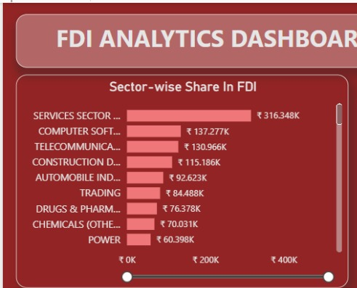
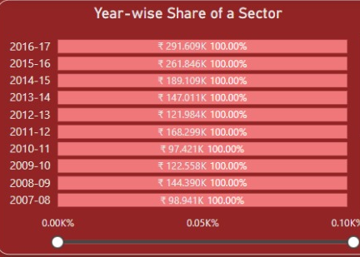
My Dashboard

Slide 7

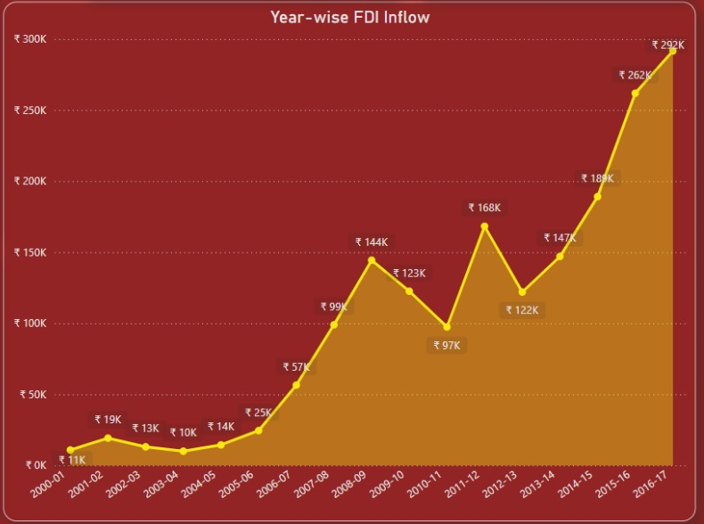
My Dashboard

Slide 8

THANK YOU

